Slide 1
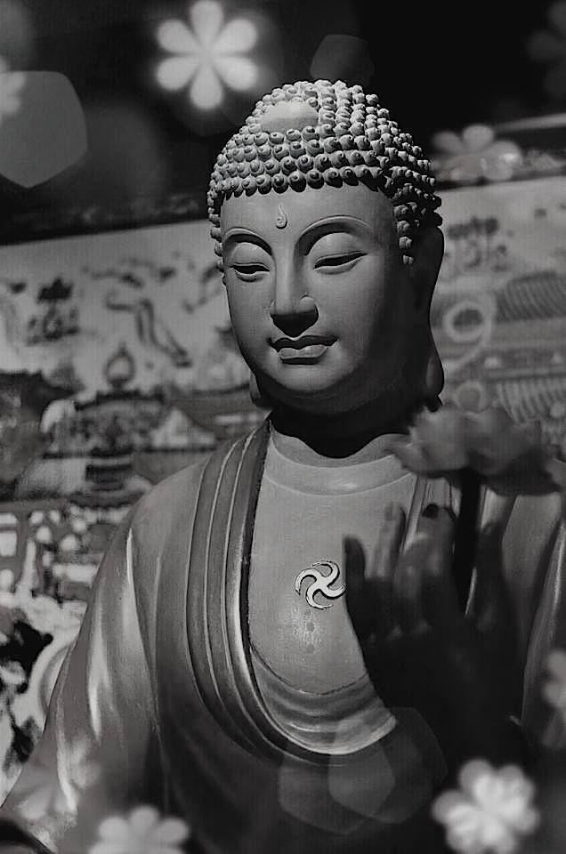
Buddhist nature of self
Kenneth K. Inada

Slide 2
Anātman
Refers to the doctrine of "non-self", that there is no unchanging, permanent self, soul or essence in living beings.
Fundamental difference with Hinduism that asserts that Ātman (soul, self) exists.
Buddha taught that "you" are not an integral, autonomous entity.

Slide 3
Place and function of metaphysics in Buddhism
Many scholars have tried to deny it.
The denial is prompted by an overly concern of Buddhist goal - Nirvāna. (Nirvana is a place of perfect peace and happiness, like heaven, a state of enlightenment, meaning a person's individual desires and suffering go away.)
The anti-metaphysical sutra, Cula-Mālukyasutta (It is fitter to speculate by striving for deliverance)
Some principal doctrines, such as sunyatā, nirvāna, dharma, pratityasamutpāda, anitya and anātman strongly suggest place of metaphysics and the function of metaphysical thinking.

Slide 4
Macrocosmic realm:
Indulge in form of objects of discourse, such as absolute, God, Brahman, One, Unity, Principle, etc.
Microcosmic realm:
To identify atomic components, such as self, soul, consciousness, elements of existence, etc.

Slide 5
Anātman and ātman
Ātman concept sees the whole from metaphysical totality. Presupposed ātman-brahman identity explicitly or implicitly from beginning to end. Aims at metaphysical absolute.
Anātman concept sees the whole as much as possible from metaphysically fragmented nature of things. No presuppositions at all and denied any bad metaphysical elements to influence such concepts as jiva(self), sattva(sentient being) and pudgala(personal identity). Aims at ontological absolute.

Slide 6
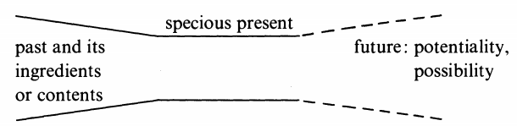
Specious present (flow of existence)
Specious present is carving out phenomenon with respect to continuum of existence. Past is necessary for present but not sufficient for its own being. Future is the latent potential of being.
The locus of reality resides in the specious present.
Buddhist will premise two kinds of continuum; being(bhava) and consciousness(santaana). Specious moment is functional in both.

Slide 7
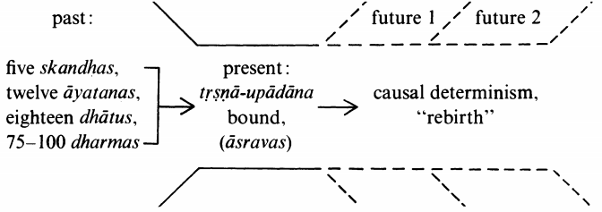
Specious present in relative to ātman-process
The present came from the past and that it will eventually enter into or become a new phenomenon known as the future.

Slide 8
Upaadaan doctrine: The passions and desires are vital parts of our experiences but they need not be restrained, they can go on in a purely detached manner without the clinging elements of being.
Rebirth-concept in Buddhism: quite problematic. Phenomenon of after-life in terms of last attachment remaining in man.

